Slide 1

Market Basket Analysis
Anticipating Customer Behaviour
CSDA1040: Advance Methods of Data Analysis
Jennifer Johnson & Jessee Ho

Slide 2
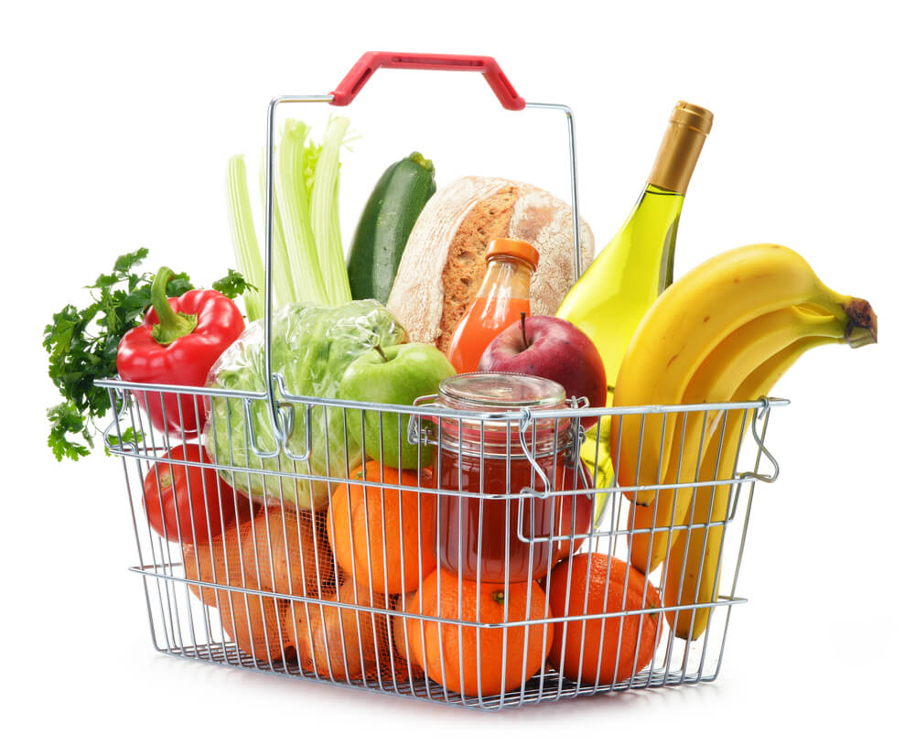
Background & Context
In the retail sector, understanding consumer preferences and trends is key to the success of the company. Market Basket Analysis or Affinity Analysis seeks to helps retailers understand their customer base to ultimately help them serve the customer better.
Our task is focused on understanding consumer behaviour by using association rule mining to predict customer purchasing patterns based on historical grocery transaction data and identify associated products.

Slide 3

Analytical Solution
1.
Data Understanding and Exploration
2.
Data Preparation
3.
Model Development
4.
Model Evaluation
5.
Deployment

Slide 4
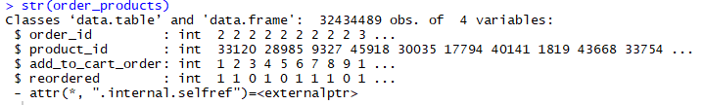
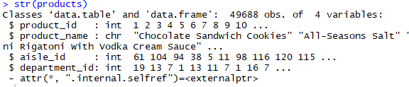
Data Understanding & Exploration
# Load data files
order_products <- fread("data/order_products__prior.csv")
products <- fread("data/products.csv")
The datasets used in our analysis is the Instacart Market Analysis Datasets which contains five tables: Aisles, Departments, Order_Products_Prior, Orders and Products relating to historical transaction data from the Instacart shopping application.
Our analysis will focus on predicting purchasing behaviours and product associations. Therefore, it was determined that the dataset pertaining to the physical store were beyond the scope of this project.
Only the Order_Products_Prior and Products datasets were chosen.
Order_products contains 4 integer variables and 32,434,489 observations. In this dataframe, we were most interested in the ‘order_id’ and ‘product_id’.
The products dataframe contains 4 variables (3 integer, 1 character) and 49,688 observations. We were most interested in the ‘product_name’ and ‘product_id’.

Slide 5
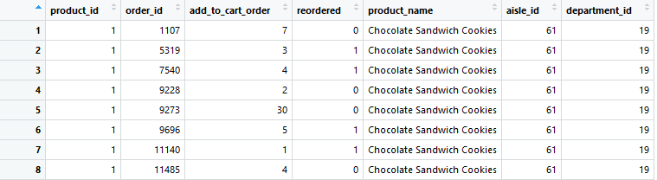
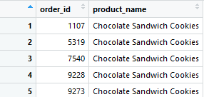
Data Preparation
# merge to get list of orders and products
order_prod_dept = merge(order_products, products, by.x="product_id", by.y="product_id")
In order to carry out our market basket analysis and determine product association, we merged the Order_products dataframe and the Products dataframe using ‘product_id’ as our association key.
We then dropped the variables deemed uninteresting such as ‘product_id’, ‘aisle_id’, ‘add_to_cart_order’, ‘reordered’, ‘department_id’ to our analysis to streamline the processes.
7 Variables x 32,434,489 observations
# drop unused columns
order_dept = select(order_prod_dept, -c(product_id, aisle_id, add_to_cart_order, reordered, department_id))
order_dept_unique <- unique(order_dept)
7 Variances x 32,434,489 observations
2 Variables x 32,434,489 observations

Slide 6
Data Cleaning
Examples:
## DATA CLEANSING
# Merge similar products together
order_dept_unique$product_name[order_dept_unique$product_name == "Bag of Organic Bananas"] <- "Banana"
order_dept_unique$product_name[order_dept_unique$product_name == "Organic Banana"] <- "Banana"
order_dept_unique$product_name[order_dept_unique$product_name == "Organic Hass Avocado"] <- "Organic Avocado"
order_dept_unique$product_name[order_dept_unique$product_name == "Organic Avocado"] <- "Avocado"
order_dept_unique$product_name[order_dept_unique$product_name == "Hass Avocados"] <- "Avocado"
order_dept_unique$product_name[order_dept_unique$product_name == "Small Hass Avocado"] <- "Avocado"
order_dept_unique$product_name[order_dept_unique$product_name == "Organic Whole Strawberries"] <- "Strawberries"
order_dept_unique$product_name[order_dept_unique$product_name == "Organic Strawberries"] <- "Strawberries"
order_dept_unique$product_name[order_dept_unique$product_name == "Large Lemon"] <- "Lemons"
order_dept_unique$product_name[order_dept_unique$product_name == "Organic Lemon"] <- "Lemons"
order_dept_unique$product_name[order_dept_unique$product_name == "Baby Seedless Cucumber"] <- "Cucumber"
order_dept_unique$product_name[order_dept_unique$product_name == "Organic English Cucumber"] <- "Cucumber"
order_dept_unique$product_name[order_dept_unique$product_name == "Cucumber Kirby"] <- "Cucumber"
order_dept_unique$product_name[order_dept_unique$product_name == "Organic Cucumber"] <- "Cucumber"
order_dept_unique$product_name[order_dept_unique$product_name == "English Seedless Cucumber"] <- "Cucumber"
...
order_dept_unique$product_name <- removeWords(order_dept_unique$product_name, "Organic ")
The data cleaning stage involved reclassifying similar items into a generic identifier and removing common unique identifiers that provided no additional value to our analysis.
A total of 24 products were reclassified. The term “Organic” was also removed as it occured in 924 unique instances creating unnecessary product differentiation.
Our resultant dataset contained 48,454 unique products.

Slide 7
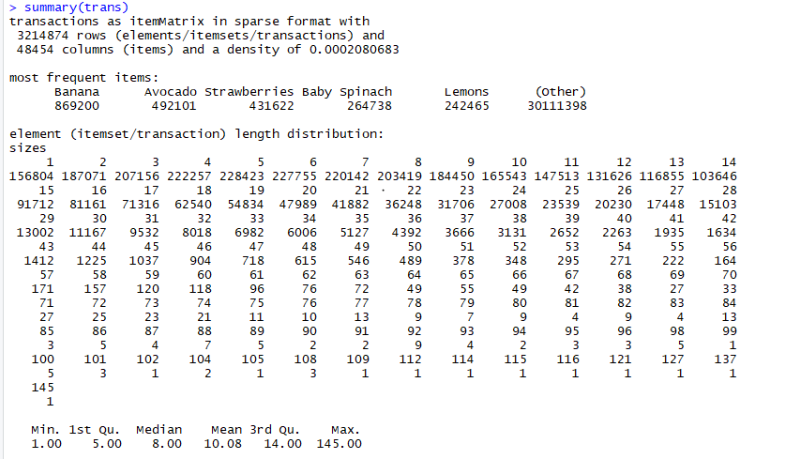
Creating Transaction Matrix
# Create transaction matrix
trans <- as(split(order_dept_unique$product_name, order_dept_unique$order_id), "transactions")
Using the cleaned dataset, we generate a transaction matrix using product_name as the column and order_id as the rows.
We can see from the transaction matrix that the top 6 purchased items are Banana, Avocado, Strawberries, Spinach and lemons.
One potential insight we can draw from the matrix is that the average consumer has about 10 items per basket.
Finally we filter the transactions to remove any transactions sizes less than 3 items to draw more meaningful insight.
# Filter transactions by size
filter_trans = trans[size(trans)>=3]
summary(filter_trans)
inspect(filter_trans[1:3])
Our filter reduces the number of transactions to 2,870,999.

Slide 8
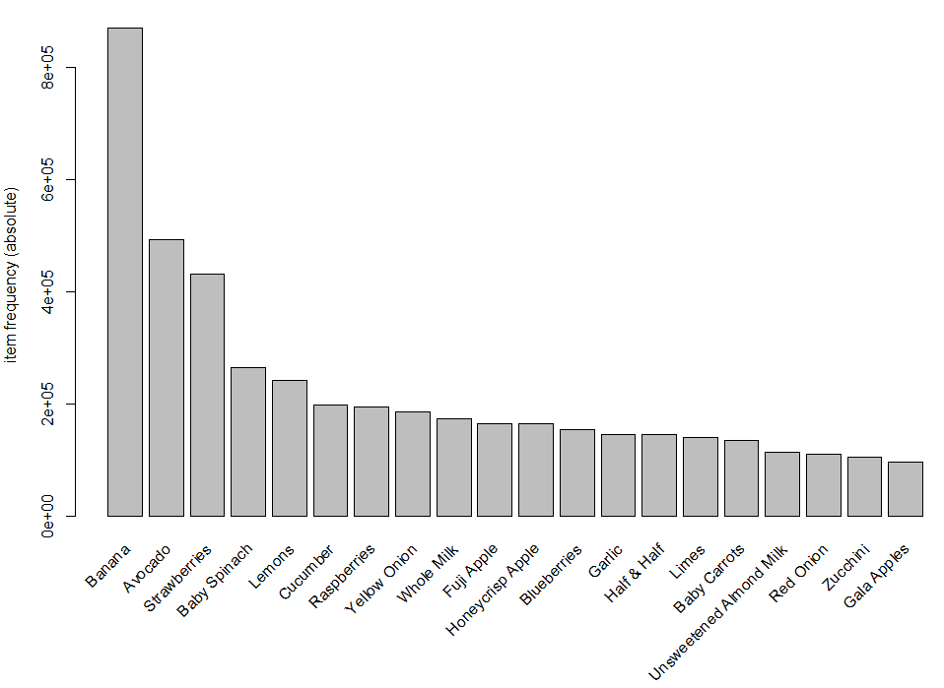
Visualizing the Transactions
This chart shows the visualization of the transaction matrix. We can see the bananas are included in 869,200 transactions or ~30% of all transactions, significantly more than the top 6 products.
We can also see that the histogram is skewed heavily right showing strong consumer preferences towards specific products.

Slide 9
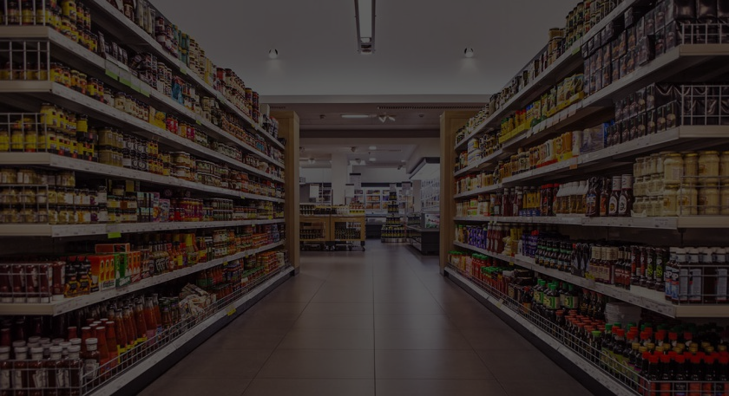
Model Development

Slide 10
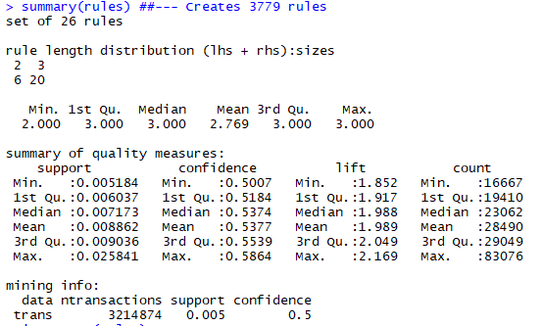
Mining Association Rules using APRIORI
# MINING ASSOCIATIONS WITH THE APRIORI RULE
rules <- apriori(trans, parameter=list(support=0.005, confidence=0.5))
inspectDT(rules)
For the purposes of analyzing the model, we utilize the parameters: support 0.005 and confidence 0.05 in order to generate a manageable 26 association rules.
In deployment, we utilized support of 0.005 and confidence of 0.25 because we wanted to make the application more flexible to client needs.
# PRUNING REDUNDANT RULES
rules.sorted = sort(rules, by="lift")
rules.pruned <- rules.sorted[!is.redundant(rules.sorted)]
In the deployment, we utilize the above pruning code to clear redundant rules. This is not necessary at the demonstration parameters of support 0.005 and confidence 0.05

Slide 11
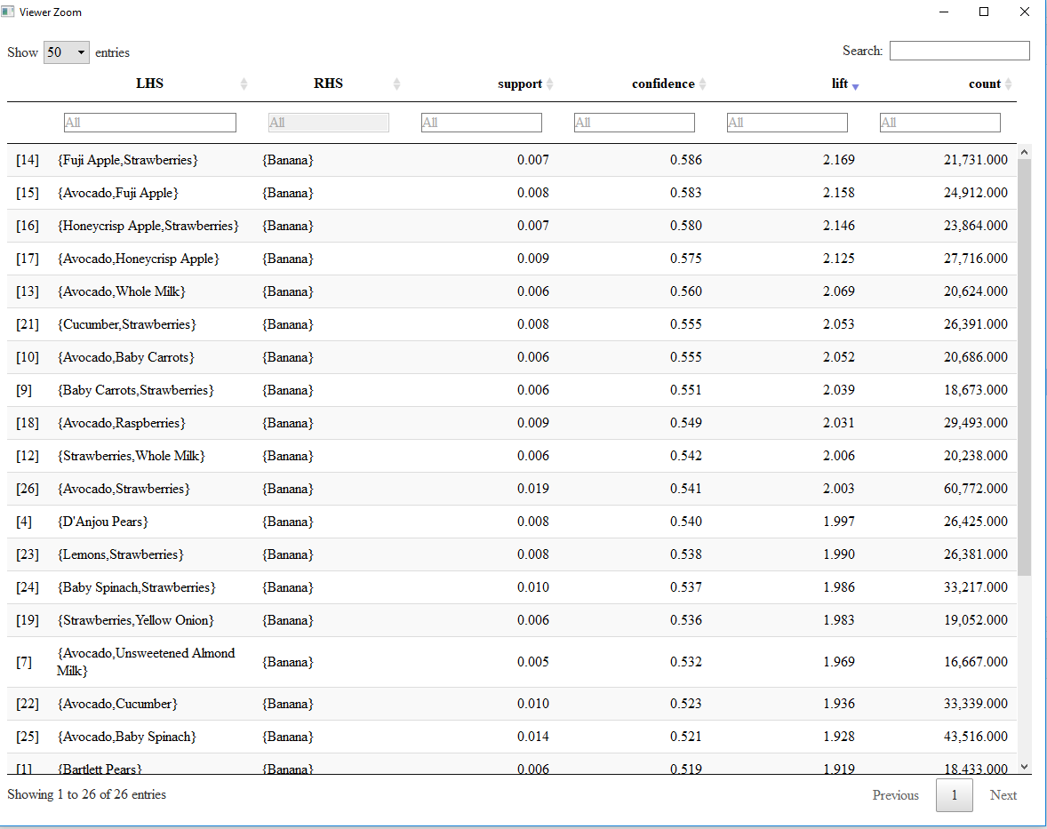
Mining Association Rules using APRIORI
Our model has identified 26 association rules with minimum lift values of 1.9 indicating that the association rules are very likely to occur.
These results can be interpreted as consumers who purchase bananas have:
58.6% chance to purchase Fuji Apples and Strawberries
58.3% chance to purchase Avocados and Fuji Apples
58% chance to purchase Honeycrisp Apples and Strawberries
And so on...

Slide 12
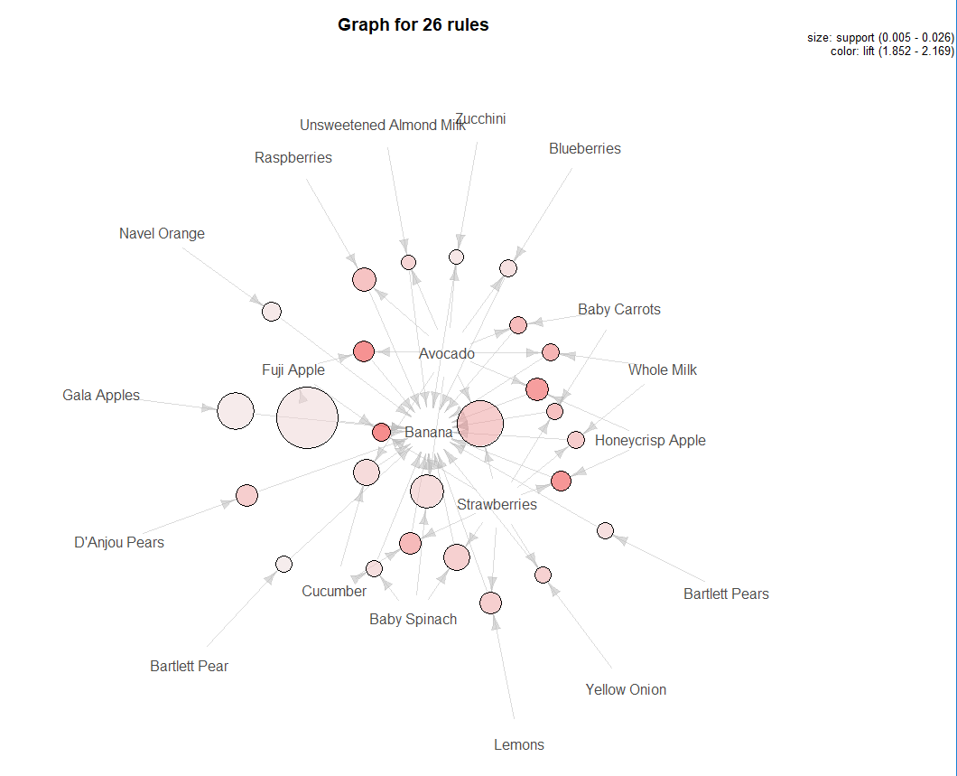
Visualization: Graph Plot
This visualization represent the rules as a graph with items labeled vertices, and rules represented as vertices connected to items using arrows.
The association rules outline in the previous slide can be visualized in this graph where banana has a strong association with Fuji Apples, Strawberries and Avocados.
Recall:
58.6% chance to purchase Fuji Apples and Strawberries
58.3% chance to purchase Avocados and Fuji Apples
58% chance to purchase Honeycrisp Apples and Strawberries
...
# Graph Plot
plot(sort(rules, by="confidence"), method = "graph")

Slide 13
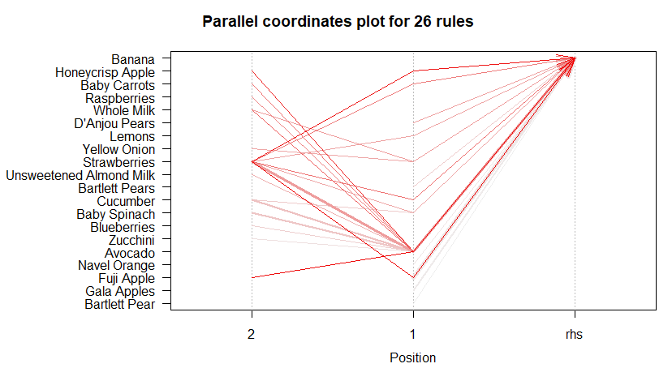
Visualization: Parallel Coordinate Plot
Another plot that can be used to visualize the association rules between Bananas, Apples, Strawberry and Avocados.
This shows the directionality of the association rules with chords stemming from the RHS banana.
# Parallel Coordinates Plot
plot(sort(rules, by="confidence"), method = "paracoord")

Slide 14
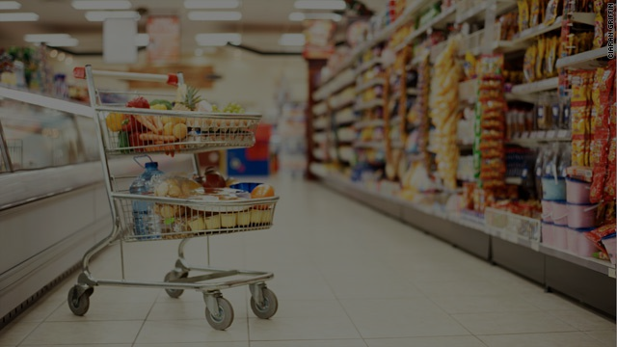
Model Evaluation

Slide 15
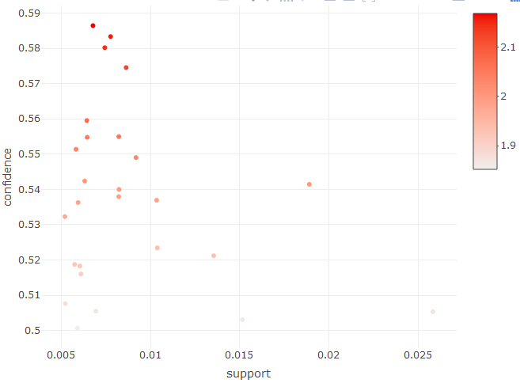
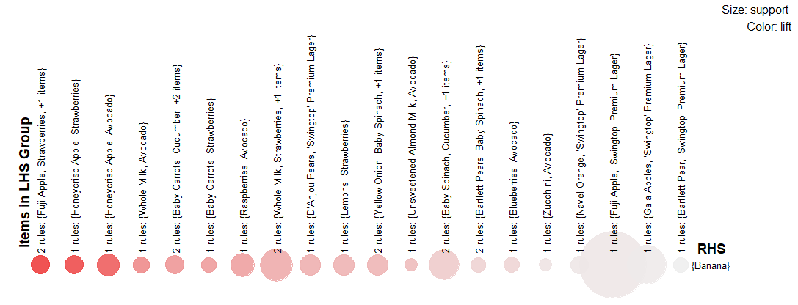
Evaluating Association Rules
Support indicates the rate of occurrence of an item in the observed transitions. Our model had a support range of 0.005 - 0.03. These support values can be improved by feeding the model more data.
Confidence determines how likely one item is to be purchased in relation to another. Our model had confidence ranges of 0.5 - 0.59 which is a relatively strong predictor.
Lift determines the strength of the association rule. In practise we will be evaluating our model based on a lift value greater than 1 to ensure the association rules are “likely” to occur. Our model had lift values ranging from 1.85 - 2.17 indicating relatively strong association rules.
Plot of 26 Association rules
# VISUALIZING ASSOCIATION RULES
plotly_arules(rules.pruned)
# Grouped matrix plot
plot(rules, method="grouped")

Slide 16
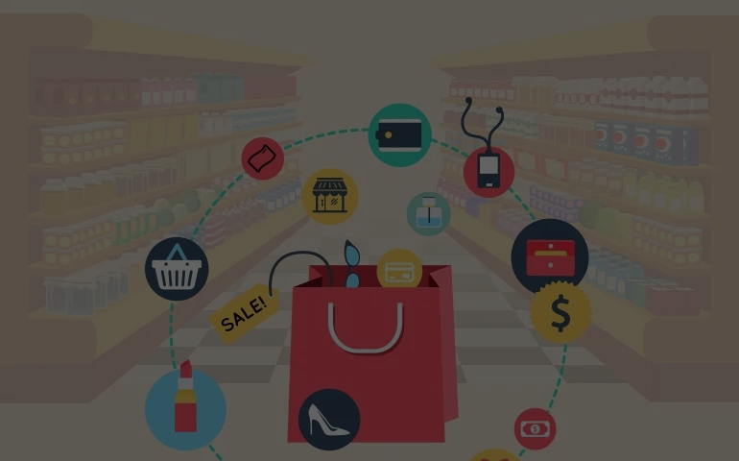
Deployment

Slide 17
SHINY APP
FAQ
How useful is your model for interested parties?
The deployed model will adjustable parameters to users can customize their support, confidence and lift levels.
How would you deploy your model for interested parties?
Deployment will be via Shiny App
What other data should be collected?
Additional product data can be collected as they become available in the retail chain. The model is highly adaptable.
How often would the model need to be updated?
The model should be updated as additional transactional data becomes available. As mentioned previously, additional data will allow for increased support values.
https://crazy8girl.shinyapps.io/association_mining/
NOTE: Shiny app uses a smaller dataset than the original due to memory load errors on shinyapps.io (Dataset is training dataset and filters to only find associations between produce items only)
CODE LOCATION: Click here to access code

